Slide 1
Shantytown Renewal and Upgrading Within Urban Areas: The experience of Liaoning, China
Chen Fei
Email: nkchenfei@yahoo.com.cn
Capital University of Economics & Business

Slide 2
Contents
The spatial structure and characteristics of shantytowns in Liaoning Province
Spatial Renewal of Liaoning Shantytowns: Optimized Layout and Balanced Allocation
Shantytown Renewal in Liaoning Province and its Influence on Urban Upgrading
Gains and Issues Deserving Further Attention

Slide 3
I. The structure and characteristics of shantytowns in Liaoning Province
First, there are a large number of shantytowns, widely spread but comparatively concentrated.
(棚户区数量众多，分布范围广但相对集中.)
Second, most of the shantytowns are located at the edge of the city.
多数棚户区位于城市边缘地带，地点相对偏僻。

Slide 4
Third, most of the shantytowns are in districts which are low-lying, prone to be waterlogged, seriously polluted, and easy to have slumping and surface subsidence.
大多处于低洼易涝、污染严重甚至易坍塌沉陷的区域。
Fourth, shantytowns are separated spatially from other parts of the city since the infrastructure and public service facilities seriously lag behind other districts.
基础设施和公共服务设施严重落后于城市其他区域，棚户区与城市其他区域在空间上相分割。

Slide 5
Fifth, most of shantytowns are mixed with large factories and mines and there is no clear distinction among various urban district functions.
大多与大型厂矿混杂、城市空间功能不分。
Sixth, poverty groups assemble and the space of rich and poor urban residents obviously divides.
贫困群体聚集，城市居民贫富的空间分化明显。

Slide 6
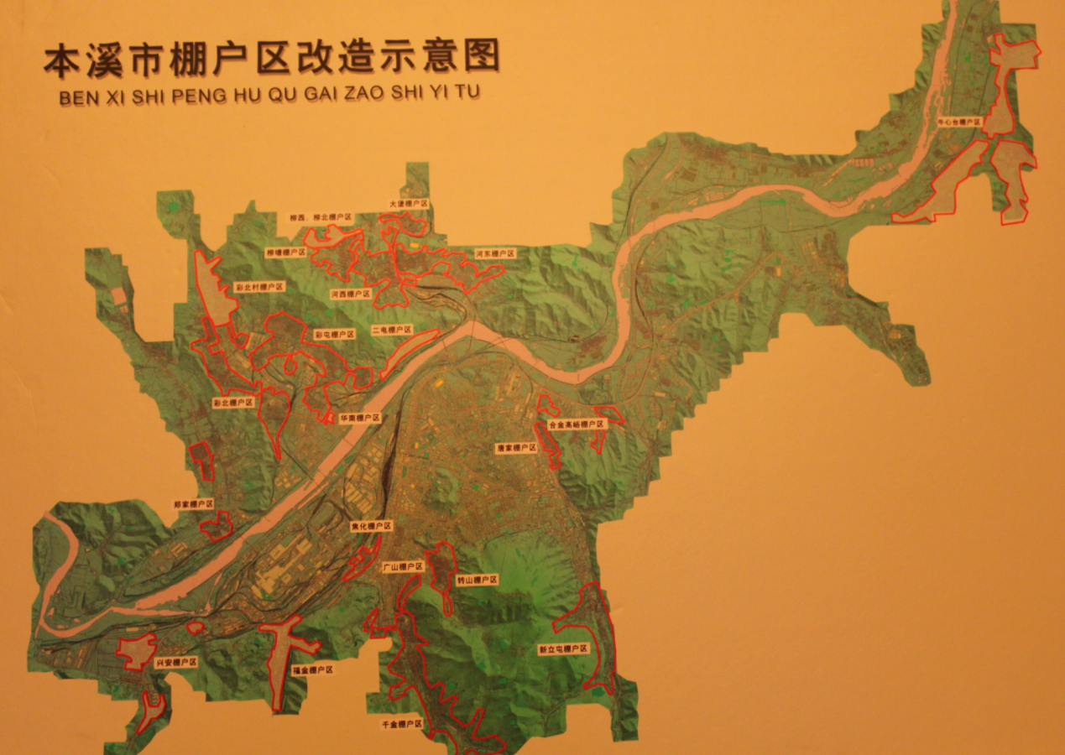
Schematic Plan of Shantytown Reformation in Benxi

Slide 7
II. Spatial Renewal of Liaoning Shantytowns: Optimized Layout and Balanced Allocation
Sticking to the principle of combination of in-situ resettlement and relocation and choosing settlements scientifically for shantytowns residents.
坚持原地安置和异地安置相结合，科学选择棚户区居民安置点

Slide 8
Sticking to the principle of “whole scattering, local concentration and individual mix” with efforts to break the spatial agglomeration of poverty.
坚持“整体分散、局部集中、个别混居”，试图打破贫困的空间聚集

Slide 9
Sticking to the principle of synchronously constructing infrastructure and service facility and perfecting ancillary functions in renovated shantytowns.
坚持建设基础设施和服务设施同步，完善棚改新区功能配套.

Slide 10
Utilizing urban spatial resources intensively and striving to make the urban functions clear.
集约利用城市空间资源，努力明晰城市空间职能.

Slide 11
Ⅲ. Its Influence on Urban Upgrading
Great changes have taken place in look and image of cities.
城市面貌根本改观、城市形象大幅提升.
Improved infrastructure and greatly enhanced urban capacity.
城市基础设施完善、城市承载力大大增强.

Slide 12
Intensified land utilization and greatly increased land revenue.
土地利用更加集约、土地收益大幅增加.
Coordinated urban districts development and promoted urban economic transformation.
城市空间发展更加平衡协调，城市经济转型成效初显。

Slide 13
Ⅳ. Gains and Issues Deserving Further Attention
Steadfast adherence to striking a balance between shantytown reformation and urban comprehensive planning to make sure reformation work scientific and rational.
坚持顶层设计、统筹规划，把棚改与城市各项规划相衔接，确保棚改工作科学合理。

Slide 14
Steadfast adherence to people first and people enjoyment, integrating shantytown reformation with convenience for people’s working and living and sequencing shantytown reformation。
坚持以民为本、便民利民，把棚改与方便居民生产生活相结合，合理设定棚改空间次序。

Slide 15
Steadfast adherence to the principle of synchronized construction of pleasant residential districts and public ancillary facilities.
坚持无缝对接、同步建设，把棚改与公共配套设施建设相统一，建设适居宜居的新社区。

Slide 16
Steadfast adherence to integrating shantytown reformation with urban districts expansion and optimizing their layouts or patterns for future development.
坚持立足长远、内优外拓，把棚改与优化城市空间布局相整合，拓宽城市未来发展空间。

Slide 17
Issues deserving further attention
How to balance concentrated and scattered resettlement.
如何有效地把握好棚户居民安置聚集与分散的最佳平衡点。

