Slide 1

Urbanization process and policies for sustainable urbanization in China
Jianfa Shen
Jianfa@cuhk.edu.hk
Research Centre for Urban and Regional Development
Department of Geography and Resource Management
The Chinese University of Hong Kong
Notes:
30 min with UC part

Slide 2
CONTENT
Introduction
Formal and informal urbanization in post-reform China
Problems of rapid urbanization in China
Urbanization process in post-reform China: a conceptual push-pull model
Measuring Urban Competitiveness from Perspective of Sustainable Development
Policy responses and options for sustainable urbanization
Conclusion and discussion

Slide 3
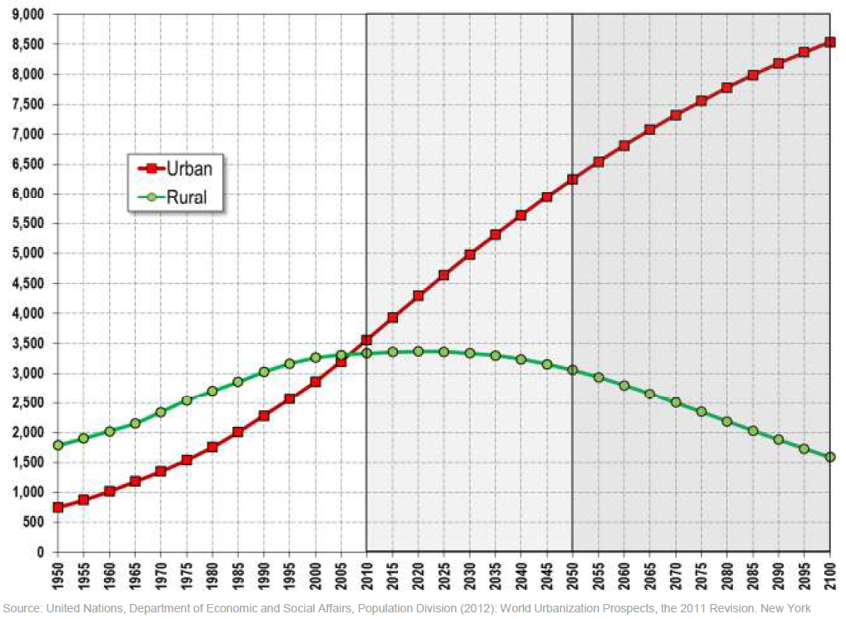
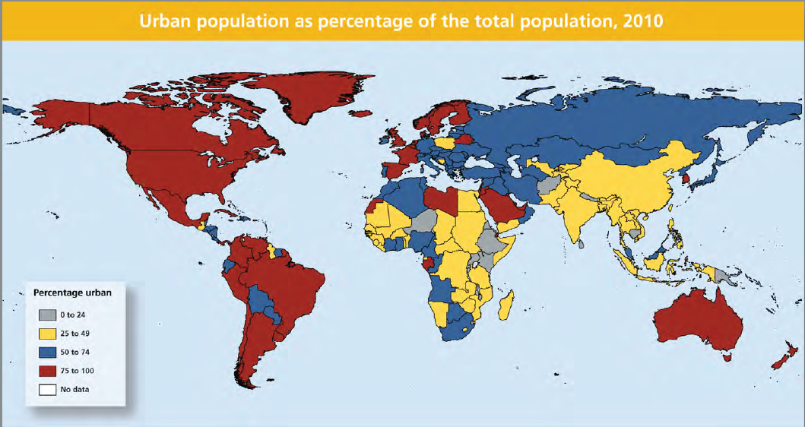
Introduction
Urban population are growing worldwide
  The developed world is already highly urbanized
  The developing world is urbanizing rapidly
Overurbanization in the developing world cities
  73.55% of the world’s urban population in 2011
  17 out of 23 largest mega-cities in 2011
  Problems of employment, poverty and housing
Notes:
Department of Economic and Social Affairs, Population Division, UN, 2012, World Urbanization Prospects: The 2011 Revision Highlights. United Nations, New York.
Million unit Left UN PPT Right fig UN, 2011, Urban Population, Development and the Environment 2011

Slide 4
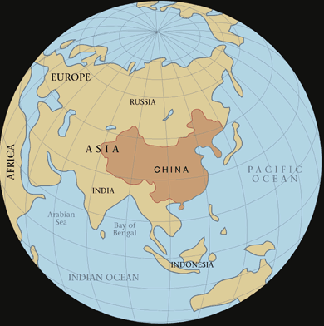

Introduction
China: one of the developing countries
  Major source of world urban population growth in 2011-2030
  19.7% from China and 15.6% from India
Research questions:
  To what extent, is urbanization in China similar to other third world countries?
  What are the problems, processes and policy responses of rapid urbanization in post-reform China?
Notes:
=
China and India will be the major source of urban population growth
To what extent, is urbanization in China similar to other third world countries?
This paper will examine the problems, processes and policy responses of rapid urbanization in post-reform

Slide 5
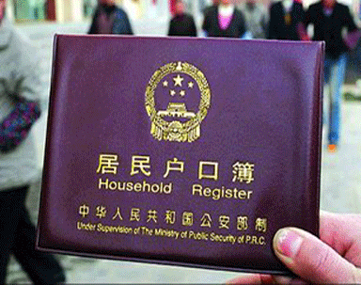
Formal and informal urbanization in post-reform China
  The Chinese household registration(hukou) system
    Place of residence and hukou category
    Non-agricultural population
    Agricultural population
  The population at a Chinese city
  Local population (urban hukou population)
    Non-agricultural population
    Agricultural population
  Migrants
    Permanent migrants (with local hukou)
    Temporary migrants (without local hukou)
      contribute to the bulk of the increased urban population
Notes:
What is urban population? People living in urban area
What is usual residents in Chinese cities? = urban population = local population + migration
Permanent migrants are agricultural or non-agricultural urban population?
Temporary migrants without hukou are agricultural or non-agricultural population out of the city?

Slide 6
Formal and informal urbanization in post-reform China
The level of urbanization
  The share of urban population in total population
  Urban population = usual residents in urban areas= local population + migrants
Formal urbanization process
  the increase in urban hukou population
  i.e., local population + permanent migrants
Informal urbanization process
  the increase in urban non-hukou population
  i.e., temporary migrants
Notes:
=
The formal and informal urbanization can be indicated by the growth of urban hukou population and temporary population.
Urban hukou population is not necessary non-agricultural population.

Slide 7
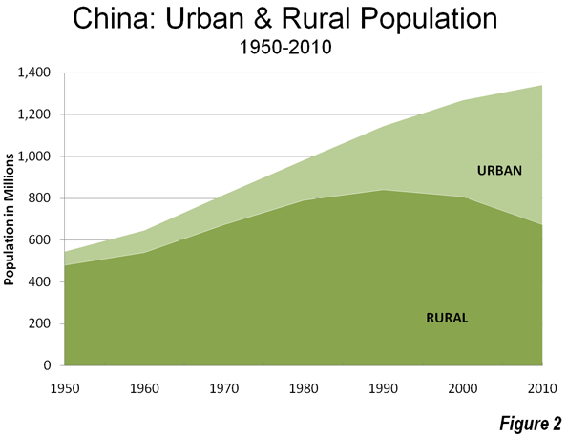
Urbanization in Post-reform China
Accelerating urbanization in China
  37% in 2000 to nearly 50% in 2010
Rapid increase in urban population
  211 million in 1982
  458 million in 2000
  666 million in 2010
Due to rapid increase in urban population including
  Hukou population: Local population + Permanent migrants
  Non-hukou population: Temporary migrants
Notes:
Fig Source: Newgeography, China: Urbanizing and Moving East: 2010 Census, at http://www.newgeography.com/content/002218-china-urbanizing-and-moving-east-2010-census
What is urban population?
Hukou agricultural
hukou non agricultural population?
Temporary population?
Local population?
== urban population
=== usual residents

Slide 8
Formal Urbanization in Post-reform China
The urban hukou population
  Increased from 145 million in 1982 to 309 million in 2000 and 358 million in 2010
  147% increase in the period 1982-2010
The formal urbanization process is strong with the pace of the total urban population growth
Share of the local hukou population in total urban population decreased
  from 75.27% in 2000 to 66.27% in 2010

Slide 9
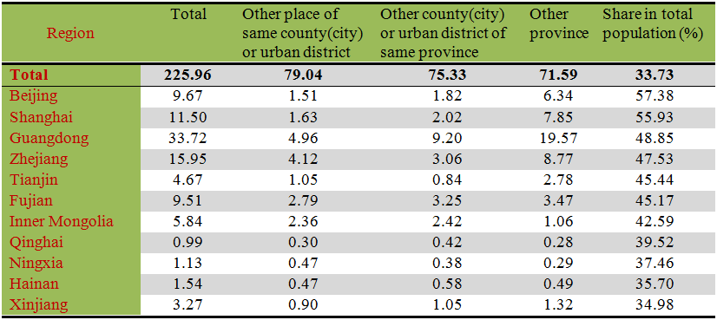
Informal Urbanization in Post-reform China
Temporary population in China
  6 million in 1982, 40 million in 1990, 144 million in 2000 (79% in urban area) and 261 million in 2010 (87% in urban area)
Urban temporary population in Chinese cities
  113 million in 2000 and 226 million in 2010
Urban temporary population in selected regions in 2010 (million)
Source: PCO and DPES (2012)
Notes:
90 million from same county (city) or urban district
Those coming from same urban district are migrants?
virtually all of Shanghai's population growth was due to migration
79% in urban area
261 million in 2010
225.96 million or 87% of temporary

Slide 10
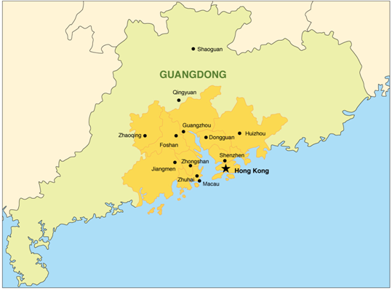
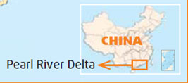
Pearl River Delta
One of the most urbanized region in China
Total population
  42.89 million in 2000
  56.16 million in 2010
Urban population (urban usual residents)
  30.71 million in 2000
  46.46 million in 2010
The level of urbanization
  71.59% in 2000
  82.72% in 2010
Total population in 2010: 56.16 million
  Hukou population: 30.25 million
  Temporary population: 25.92 million and 46.15% of total population

Slide 11
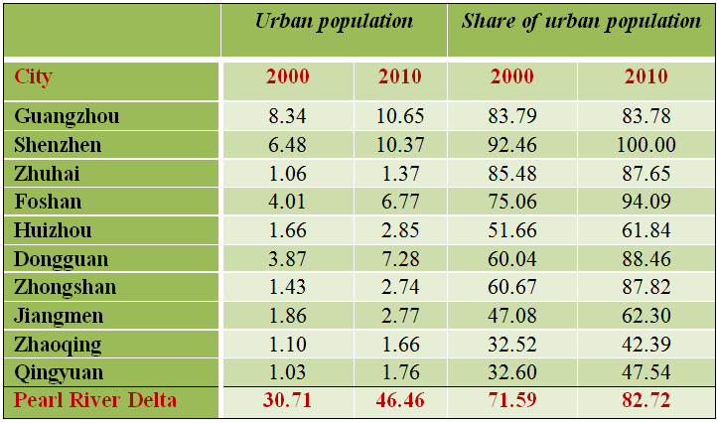
Formal and Informal Urbanization in PRD
Growth of Urban Population in Pearl River Delta in 2000-2010
Data source: SBGP and GSONBS (2011)

Slide 12
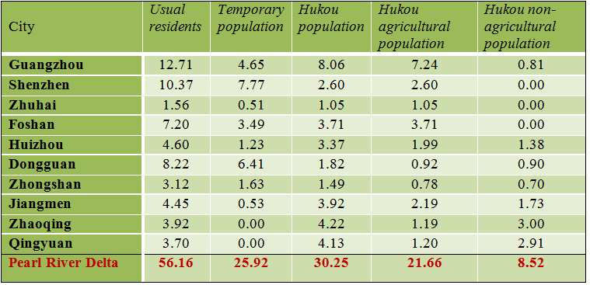
Formal and Informal Urbanization in PRD
Temporary Population in Pearl River Delta in 2010 (Million)
Data source: SBGP and GSONBS (2011)

Slide 13
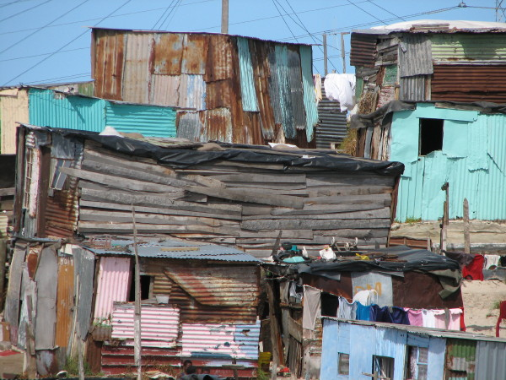
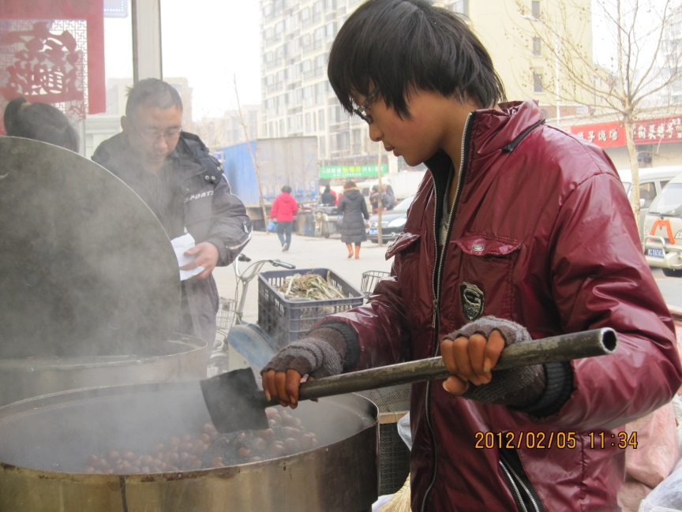
Challenges of Rapid Urbanization in China
Rapid growth in urban population
  Many temporary migrants
Similar to other third world cities, inadequate development in urban infrastructure
Two urban problems
  Housing quality and quantity
  Informal economy

Slide 14
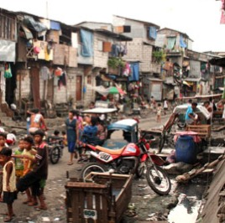
Housing Quality and Quantity in Chinese Cities
  Inadequate housing and low housing quality in 2005 and 2010
  Floor space per person: 27.51 to 32.74 square meters
  Share of households with floor space less than 8 square meters per person: 8.05% to 6.82%
  Share of households lived in housing units without kitchen: 9.49% to 9.97%
  Households without toilet: 15.13% to 15.63%
  Households without piped water: 13.73% to 13.35%
Much worse housing condition for temporary population
Differing from the developing world countries, the squatting problem in not widespread in Chinese cities
Notes:
8.05% of households had floor space less than 8 square meters per person 人均住房建筑面积 2010 china census
City 8249325 no house 8739 less than 8 sq m 683910
Town 5537545 no house 10154 less than 8 sq m 236314
Urban area 13786870 ; 19893 + 920224= 940117 6.82%
9.97%households lived in housing units without kitchen: city 1018077 town: 973476=1991553
15.63%households without toilet 1356496 1765418=3121914
13.35%households without piped water 847051 1820003=2667054
12416562 7554783=19971345
1% population sample survey in 2005
the floor space per person was 27.51 square meters in urban areas
8.05% of households had floor space less than 8 square meters per person
9.49% of households lived in housing units without kitchen
15.13% households without toilet
13.73% households without piped water

Slide 15
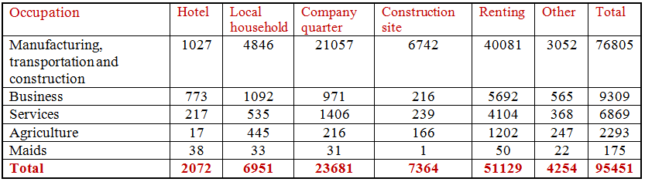
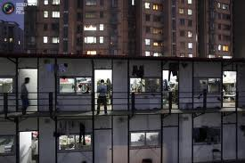
Housing Tenure of the Temporary Population by Occupation in Chinese Cities 2010 (thousand)
Data source: Administration Bureau of Household Registration (2010: 4-5)
53.57% in rented accommodation
24.81% lived in company quarters
7.71% in construction sites
7.28% in local households

Slide 16
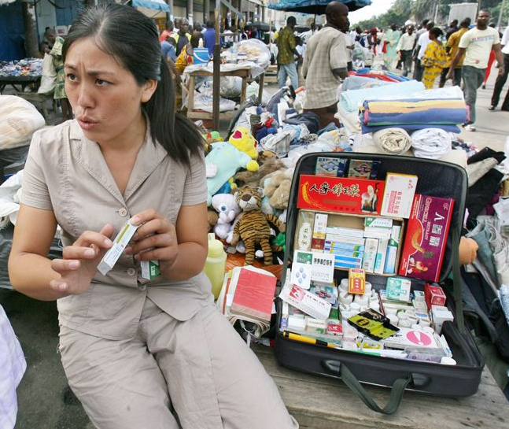
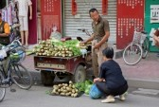
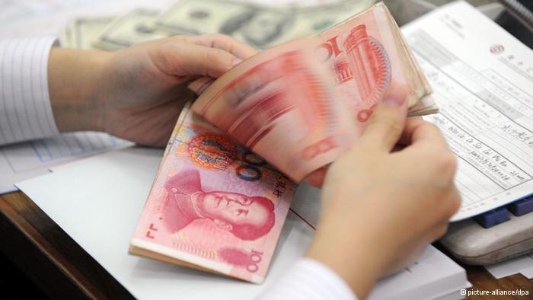
Informal Economy in Chinese Cities
Rapid growth in temporary migrants
Problems of unemployment
  education attainment, technical skill, …
Informal economy
  Provide services to local residents, not attractive for local residents
Poverty and social problems
  Low income, poor working environment, …
Notes:
Urbanization ≠ urban growth
Widely observable in urban china
Many open market, street retailing activities, hawkers

Slide 17
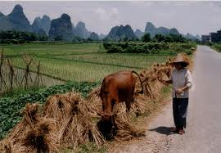
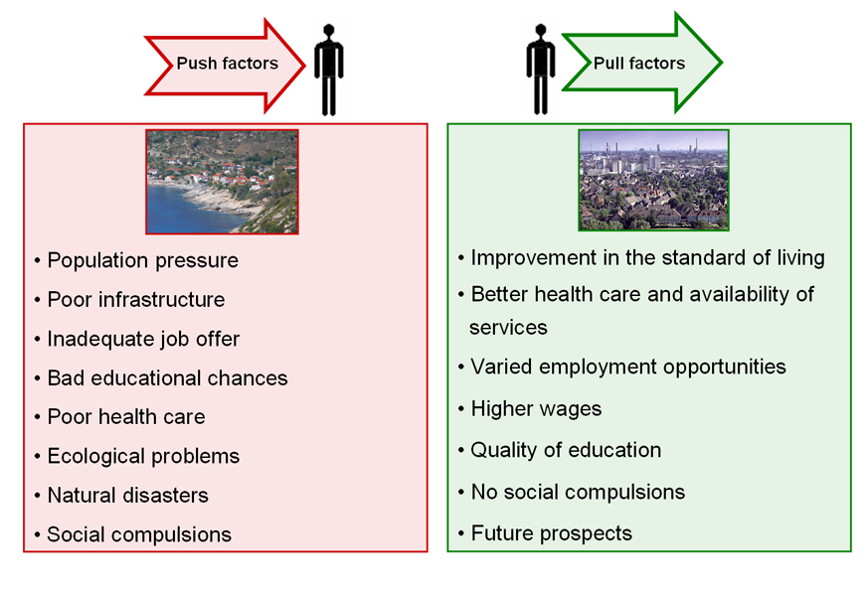
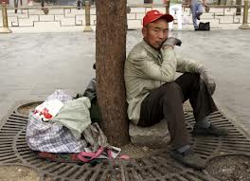
Reflection
Urbanization Process in China
Urbanization means
  not only population shift from rural to urban areas and the employment shift from farming to industries and services
  but also improving qualities of urban life
    Including decent housing and working conditions, quality facilities, services and environment
To have a better understanding on the emergence of urban problem in Chinese cities
  it is important to examine the institutional basis and the pull and push factors of rural-urban migration
Notes:
Urbanization involves population shift from rural to urban areas and the employment shift from farming to industries and services.
not only an increase in the sizes of urban population and employment
Many theoretical studi.
The traditional theory of rural-urban transition assumes that population concentration in urban areas would be an inevitable outcome of economic growth due to scale and agglomeration economies. It focuses on the process of rural to urban transition emphasizing the dichotomy of urban and rural areas. es and empirical modelling have been conducted to illustrate the rural-urban transition
McGee and Ginsburg developed an alternative model of urban transition, the extended metropolis (desakota) in Asia (Ginsburg, 1991; McGee, 1991). McGee and Ginsburg's model was concerned about the special spatial configuration of urbanization in Asia emphasizing a blurring of urban and rural distinction. The model applies to cases in Asia where a process of "urbanization of countryside" is taking place and rural people do not have to move to cities.
The study on urbanization in China has ignored this quality aspect.

Slide 18
A Conceptual Push-Pull Model
Push and Pull Factors of Rural to Urban Migration
Notes:
The large scale rural to urban migration in post-reform China is a result of changing barriers to migration and various push and pull factors (Figure 1).
The rural to urban migration process in China was subject to strong government intervention via the household registration system and was significantly different from those in other third world countries in pre-reform period.
The rural peasants with the status of "agricultural population" were not allowed to move into cities without official approval in that period. But policy change since the early 1980s in China has generated uncontrolled mass migration similar to other third would countries.

Slide 19
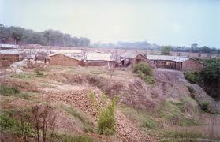
A Conceptual Push-Pull Model
Push and Pull Factors of Rural to Urban Migration
Strong push factors in the rural areas
  Rural/agricultural reform since 1978
    Household responsibility system
  Increased agricultural productivity
  Released a large number of surplus rural labourers
  Rapid population growth
  Less economic opportunity, low income and low quality of life

Slide 20
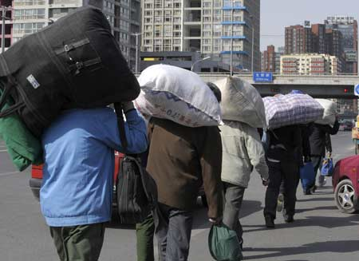
A Conceptual Push-Pull Model
Push and Pull Factors of Rural to Urban Migration
Strong pull factors in the urban areas
  Urban reform and economic growth
  Be allowed to be registered as temporary population
    “blue-chop” hukou status
    “qualified investors/migrants” becoming permanent urban residents
  Employment opportunities
    Demand for cheap labour
    Temporary migrants accessible to the low wage job

Slide 21
Social Consequences of Informal Urbanization
Hukou system as a powerful tool in Chinese cities
  to discriminate against temporary migrants
  to protect the employment and welfare of the local residents
The non-hukou migrants have to accept the 3-D low wage jobs and poor living conditions
  Dirty, difficulty and dangerous
The non-hukou migrants have little access to many urban services and welfare supports
  Education, employment, medical services, …
  Recent studies show that some migrants have adopted a split household strategy leaving children, wife or elderly in rural areas
Notes:
=
Some rural migrants have the intention to return to rural areas

Slide 22
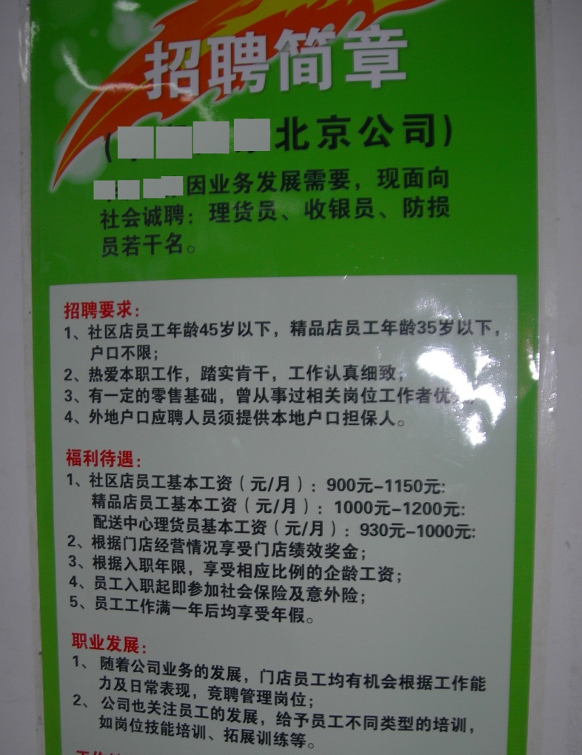
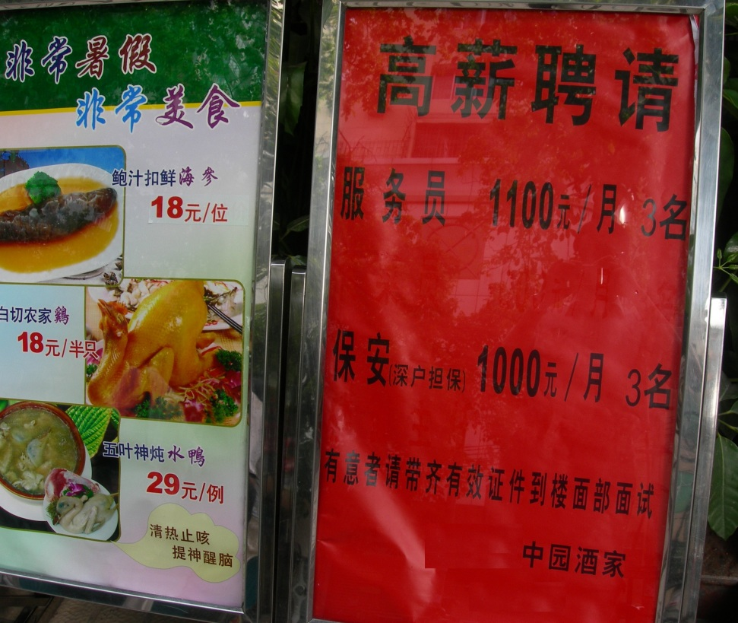
A migrant needs a guarantor with local hukou to get a security job in Shenzhen in 2007 and a job in a supermarket in Beijing in 2008

Slide 23

Measuring Urban Competitiveness from Perspective of Sustainable Development
Study area and data
24 major cities
4 municipalities
  Beijing, Shanghai, Tianjin and Chongqing
15 sub-provincial cities
  Dalian, Harbin, Changchun, Shenyang, Hangzhou, Jinan, Nanjing, Ningbo, Qingdao, Xiamen, Wuhan, Guangzhou, Shenzhen, Chengdu and Xi’an
5 rapidly rising cities
  Suzhou, Wuxi, Wenzhou, Dongguan and Zhuhai

Slide 24
Measuring Urban Competitiveness from Perspective of Sustainable Development
Table 1 The urban competitiveness evaluation system
Index (Level I) | Component (Level II) | Group (Level III)
Urban competitiveness index | Economic competitiveness (E) | Economic output (E1)
 |  | Growth potential (E2)
 |  | Economic structure (E3)
 |  | Economy efficiency (E4)
 | Social competitiveness (S) | Education (S1)
 |  | Knowledge and technology (S2)
 |  | Quality life (S3)
 |  | Public infrastructure (S4)
 |  | Government efficiency (S5)
 | Environmental competitiveness (N) | Urban landscape (N1)
 |  | Environment and hygiene (N2)
 |  | Treatment and control (N3)
 | External connection competitiveness (C) | Trade and foreign investment (C1)
 |  | Tourism and exchange (C2)
 |  | Accessibility and capacity(C3)

Slide 25
Measuring Urban Competitiveness from Perspective of Sustainable Development
Shanghai, Beijing, Shenzhen, Guangzhou, Dalian, Suzhou, Xiamen, Nanjing, Zhuhai and Qingdao were top ten cities
Figure 1 Scores of urban competitiveness index and its four components in 2008

Slide 26
Measuring Urban Competitiveness from Perspective of Sustainable Development
Generally consistent ranks in economic, social, environmental and external connection competitiveness with only a few exceptions
Shanghai and Beijing only ranked 13th and 14th in environmental competitiveness, need to improve urban greenery and environmental protection
Table 2 Ranks of urban competitiveness index and its four components in 2008
City | U | E | S | N | C
Shanghai | 1 | 4 | 1 | 13 | 1
Beijing | 2 | 1 | 2 | 14 | 3
Shenzhen | 3 | 3 | 4 | 3 | 5
Guangzhou | 4 | 2 | 3 | 10 | 2
Dalian | 5 | 5 | 14 | 5 | 7
Suzhou | 6 | 7 | 6 | 6 | 9
Xiamen | 7 | 15 | 11 | 1 | 6
Nanjing | 8 | 10 | 5 | 7 | 10
Zhuhai | 9 | 16 | 22 | 2 | 4
Qingdao | 10 | 9 | 10 | 8 | 11
Hangzhou | 11 | 11 | 9 | 9 | 12
Wuxi | 12 | 6 | 18 | 4 | 14
City | U | E | S | N | C
Tianjin | 13 | 12 | 7 | 16 | 8
Shenyang | 14 | 8 | 12 | 12 | 17
Ningbo | 15 | 14 | 13 | 11 | 13
Jinan | 16 | 13 | 8 | 21 | 23
Chengdu | 17 | 19 | 16 | 15 | 21
Changchun | 18 | 17 | 17 | 18 | 20
Dongguan | 19 | 20 | 23 | 17 | 15
Wuhan | 20 | 21 | 21 | 19 | 16
Xian | 21 | 23 | 19 | 22 | 19
Chongqing | 22 | 24 | 24 | 20 | 18
Harbin | 23 | 22 | 15 | 23 | 22
Wenzhou | 24 | 18 | 20 | 24 | 24
26

Slide 27


Policy responses and options for sustainable urbanization
Dilemma situation in Chinese cities
  Demand labour force from temporary migrants
  Could not provide the social welfare to them
Should the government and the society encourage, control or regulate such informal but “legal” migration?

Slide 28

Policy responses and options for sustainable urbanization
Rural areas:
  Improvement in economic conditions, infrastructure and community services
Urban areas
  Regulation of the housing market
    housing standard (structure and space)
    Penalty system for vitiating the regulation
    Tight law enforcement for illegal squatting
  Equal opportunity in labour market
  Regulation of the minimum standard of working conditions
  Introduction of minimum wage
  New hukou policies
Notes:
Many options are available for Chinese cities to control the gate of rural to urban migration
in an indiscriminative and neutral manner ensuring the quality of urban housing, employment, public space and the urban life
For illegal squatting and hawking in the street there should be tight law enforcement
The minimum wage can be increased to raise the migrant income as well as the labour cost
If workers are guaranteed certain income for a reasonable urban life, then the problem of urban poverty could be solved
Maintain certain wage standards also have the effect of reducing the excess demand for cheap migrant workers
For illegal squatting
there should be tight law enforcement
Neutral instead of discriminative barriers for migrants could be established
the same regulations could apply to both the migrants and the local residents

Slide 29

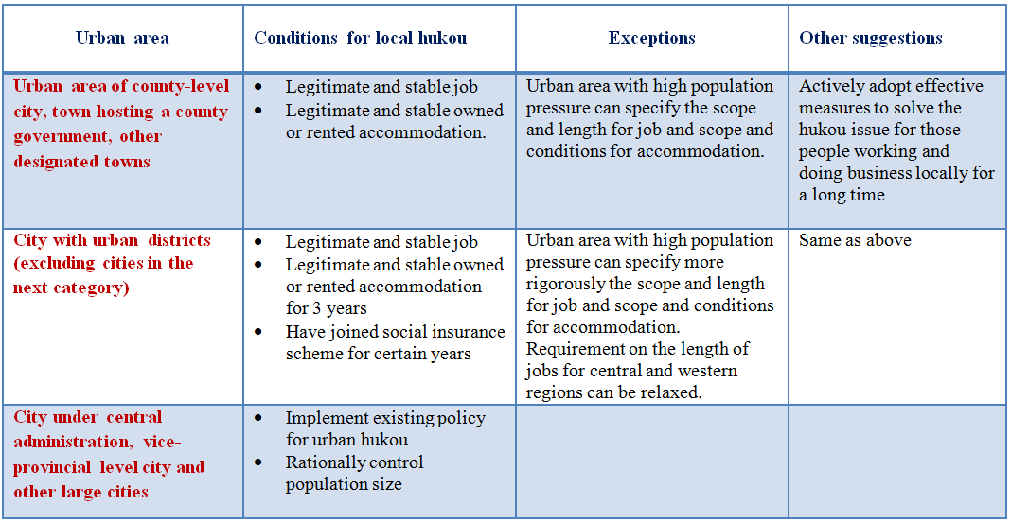
New Hukou Policies in 2011
Source: General Office of State Council, 2011, Notice of General Office of State Council on actively and stably moving forward the reform of hukou administration system, (2011) No 9.

Slide 30
Conclusion
Chinese cities also share common features of low housing quality and a large informal sector with other third world cities
One major difference between China and other third world countries is the role of household registration system in urban China
The rural non-hukou migrants form a special migrant class subject to the restrictions and discriminations imposed by the government and/or the public
It is argued that such measures should be abolished and other more fair and neutral polices could be introduced to influence the scale of rural to urban migration

