Slide 1


Erasmus University Rotterdam
Global Urban Competitiveness Project iUrban Conference
Barcelona and the new inclusive growth strategy
Joan Trullén
Institut d’Estudis Regionals I Metropolitans de Barcelona
Vice-president of Strategic Planning
Àrea Metropolitana de Barcelona
April 9th, 2014

Slide 2


Contents:
  Introduction
  Barcelona 1986-2013: economy and society
  The new inclusive growth strategy for Barcelona
  Conclusions
Notes:
2

Slide 3
  1. Introduction and objectives
  1. Introduction
Theoretical framework:
  The process of economic growth…
  Piketty (Capital in the XXI Century): Is it inexorable linked with an increase of inequality?
  Kuznets (curve): Is it inexorable linked with the reduction of inequality?
    In a stable macroeconomic environment, urban and metropolitan policies can achieve economic growth and greater income equality at the same time
3
Notes:
3

Slide 4
  1. Introduction and objectives
  1. Introduction
Cities as actors for inclusive growth
  Potential of cities to foster inclusive growth
  Central role of macroeconomic policies to promote welfare state
  Role of urban and metropolitan policies to promote growth and inclusiveness
Barcelona as an example of success of urban policies that foster inclusive growth between 1985 and 2006
4
Notes:
4

Slide 5
Contents:
  Introduction and objectives
  Barcelona 1986-2013: economy and society
  The new inclusive growth strategy for Barcelona
  Conclusions
Notes:
5

Slide 6

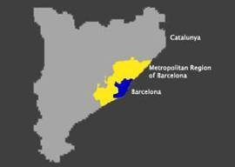
  1. Introduction and objectives
  2. Barcelona 1986-2013: economy and society
6
Notes:
6

Slide 7
  1. Introduction and objectives
  2. Barcelona 1986-2013: economy and society
The evolution of the metropolis of Barcelona from 1985 to 2006:
  The metropolis of Barcelona has been a pioneer in the design of urban strategies that promote economic growth and correct the inequality
  Economic growth between 1985 and 2006 resulted in the creation of 1.2 million new jobs) (Barcelona province).
  The Gini index of disposable income reduces from 0.39 in 1985 to 0.29 in 2006
7
Notes:
7

Slide 8
  1. Introduction and objectives
  2. Barcelona 1986-2013: economy and society
Jobs in Barcelona from 1977 to 2013 and trend for 2023 (thousands)
Source: IERMB from INE
8
Notes:
8

Slide 9
  1. Introduction and objectives
  2. Barcelona 1986-2013: economy and society
How has expanded geographically the metropolis of Barcelona?
The metropolis of Barcelona between 1986 and 2001 has consolidated as a large European metropolis.
In 2001, the metropolitan labor market already included half of the province of Barcelona.
The expansion of the metropolis takes place simultaneously with the expansion of the foreign markets in the European Union.
9
Notes:
9

Slide 10
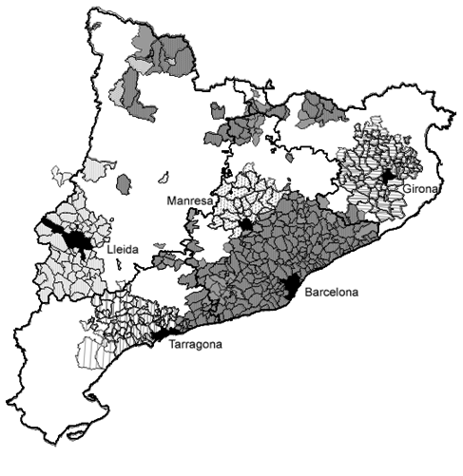
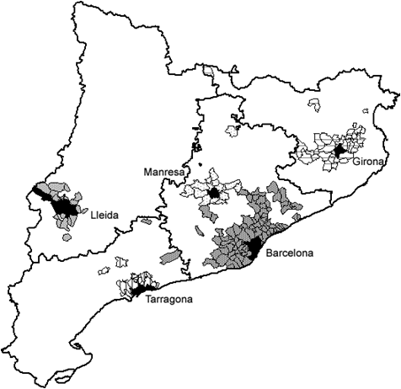
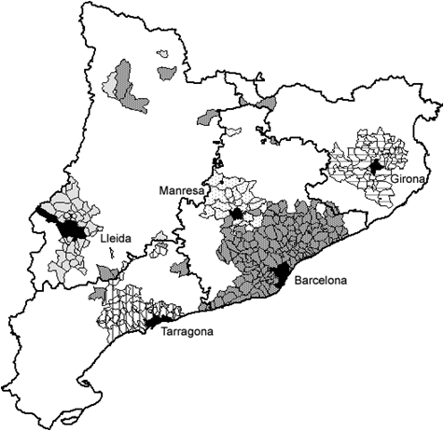
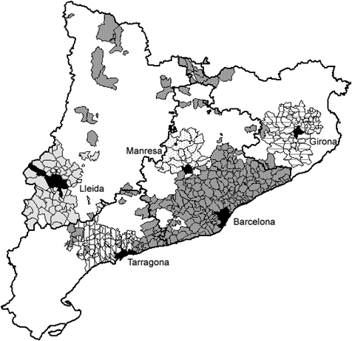
  1. Introduction and objectives
  2. Barcelona 1986-2013: economy and society
The process of territorial expansion of the metropolitan areas in Catalunya. 1986-2001
a) 1986
b) 1991
c) 1996
d) 2001
Source: Trullén and Boix (2000), Boix and Galletto (2004), and Boix and Veneri (2008).
10
Notes:
10

Slide 11
  2. Barcelona 1986-2013: economy and society
The metropolitan region of Barcelona
Territorial expansion and formation of the metropolitan area from 1986
  164 cities
  4.8 millions inhabitants
  2.2 millions jobs
  Employment growth rate: 2.6% annual average from 1991 to 2008.
Polycentric network of cities
Source: Trullén and Boix (2006)
11

Slide 12
  1. Introduction and objectives
  2. Barcelona 1986-2013: economy and society
Foreign sector
Contribution of domestic and foreign demand to GDP growth in Spain, in percentage points, 2001 - 2013
Source: INE
12
Notes:
12

Slide 13
  1. Introduction and objectives
  2. Barcelona 1986-2013: economy and society
Foreign sector
Weight of Catalan and Spanish exports over EU-15 and world, 1995-2012
Source: IERMB from WTO Statistics database, DATACOMEX (AEAT) and Eurostat.
13
Notes:
13

Slide 14
  1. Introduction and objectives
  2. Barcelona 1986-2013: economy and society
How has the crisis affected the metropolis of Barcelona?
The crisis between 2008 and 2013 has led to the destruction of 0.5 million jobs (Barcelona province).
The Gini index of disposable income increases from 0.29 in 2006 to 0.33 in 2011.
In five years (2006-2011), income distribution has worsened to the level of 1995.
14
Notes:
14

Slide 15
  1. Introduction and objectives
  2. Barcelona 1986-2013: economy and society
Income and living conditions
Gini index of disposable income. Barcelona and Barcelona Metropolitan Area (BMA), 1985-2011.
Source: IERMB, Survey on Living Conditions and Habits of the Population, 1985-2000; Idescat and IERMB, Survey on Living Conditions and Habits of the Population, 2006-2011.
15
Notes:
15

Slide 16
  1. Introduction and objectives
  2. Barcelona 1986-2013: economy and society
Income and living conditions
S80/S20 ratio of disposable income. Barcelona and Barcelona Metropolitan Area (BMA), 1985-2011.
Source: IERMB, Survey on Living Conditions and Habits of the Population, 1985-2000; Idescat and IERMB, Survey on Living Conditions and Habits of the Population, 2006-2011.
16
Notes:
16

Slide 17
  1. Introduction and objectives
  2. Barcelona 1986-2013: economy and society
Income and living conditions
S90/S10 ratio of disposable income. Barcelona and Barcelona Metropolitan Area (BMA), 1985-2011.
Source: IERMB, Survey on Living Conditions and Habits of the Population, 1985-2000; Idescat and IERMB, Survey on Living Conditions and Habits of the Population, 2006-2011.
17
Notes:
17

Slide 18
  1. Introduction and objectives
  2. Barcelona 1986-2013: economy and society
Income and living conditions
Type of household according to kinship. Barcelona Metropolitan Area, 1985-2011.
Population over 18 years
Note: Data for 1985 refer to the 27 municipalities of the former Metropolitan Corporation of Barcelona.
Source: IERMB, Survey on Living Conditions and Habits of the Population, 1985-2000; Idescat and IERMB, Survey on Living Conditions and Habits of the Population, 2006-2011.
18
Notes:
18

Slide 19
  1. Introduction and objectives
  2. Barcelona 1986-2013: economy and society
Income and living conditions
Place of Birth. Barcelona Metropolitan Area, 1985-2011.
Population over 18 years
Note: Data for 1985 refer to the 27 municipalities of the former Metropolitan Corporation of Barcelona.
Source: IERMB, Survey on Living Conditions and Habits of the Population, 1985-2000; Idescat and IERMB, Survey on Living Conditions and Habits of the Population, 2006-2011.
19
Notes:
19

Slide 20
  1. Introduction and objectives
  2. Barcelona 1986-2013: economy and society
Income and living conditions
Level of finished studies. Barcelona Metropolitan Area, 1990-2011.
Population over 18 years
Note: Data for 1985 refer to the 27 municipalities of the former Metropolitan Corporation of Barcelona.
Source: IERMB, Survey on Living Conditions and Habits of the Population, 1985-2000; Idescat and IERMB, Survey on Living Conditions and Habits of the Population, 2006-2011.
20
Notes:
20

Slide 21
Contents:
  Introduction and objectives
  Barcelona 1986-2013: economy and society
  The new inclusive growth strategy for Barcelona
  Conclusions
Notes:
21

Slide 22
  1. Introduction and objectives
  3. The new inclusive growth strategy for Barcelona
    Against the crisis: the metropolis of Barcelona
    Barcelona is the “engine” of the Spanish exports (20% of Spanish exports)
    Barcelona has to lead the Spanish recovery from the crisis
    So, it’s necessary to enhance the competitiveness and productivity
    Territorial factors of productivity:
    Interaction between economy and urbanism
    Metropolitan infrastructures: strategic role of the airport/port and of Intermodal railway station of La Sagrera
      The metropolitan strategy has a key role in the recovery from the crisis
22
Notes:
22

Slide 23
  3. The new inclusive growth strategy for Barcelona
Local factors to increase productivity
23
Notes:
23

Slide 24
  1. Introduction and objectives
  3. The new inclusive growth strategy for Barcelona
Policy strategies for the Barcelona Province
Source: Trullén 2011, Camagni 2011 ESPON Project
24
Notes:
24

Slide 25
  1. Introduction and objectives
  3. The new inclusive growth strategy for Barcelona
Strategy for the metropolitan region of Barcelona: metropolitan area, orbital cities and transversal axis
Source: Trullén 2011
25
Notes:
25

Slide 26
  1. Introduction and objectives
  3. The new inclusive growth strategy for Barcelona
    The Metropolitan Area of Barcelona and the European mega regions:
      a new territorial framework for a new metropolitan strategy
      The European mega regional dynamic
      The Lyon – Barcelona mega region
      Indicators of economic activity
      Indicators of innovative activity
26
Notes:
26

Slide 27
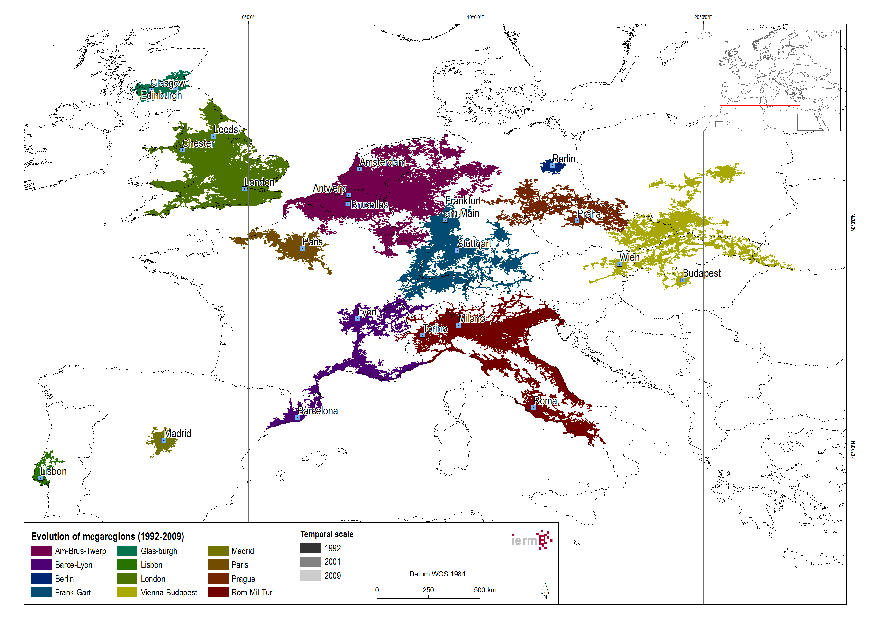
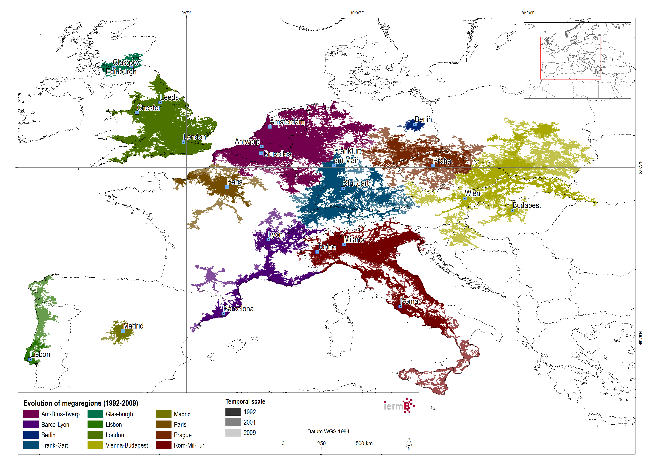
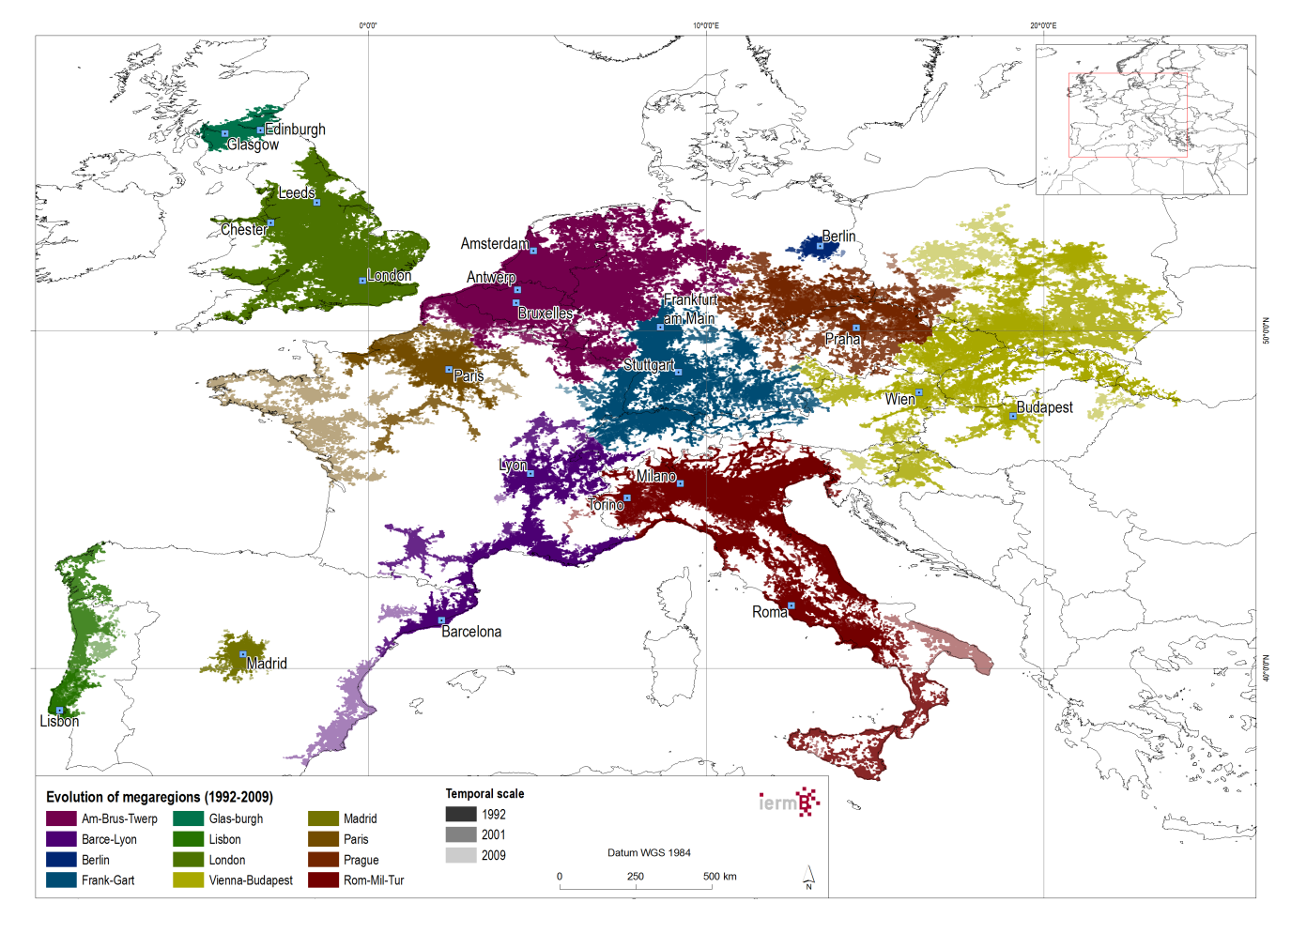
  3. The new inclusive growth strategy for Barcelona
Evolution of the twelve European mega regions (1992-2009)
Main characteristics of the European mega regions (2009)
Mega-region | Population | km² | inhab/km²
Am-Brus-Twerp | 62.331.069 | 166.218 | 375
Barce-Lyon | 29.067.891 | 111.816 | 260
Berlin | 4.540.513 | 5.566 | 816
Frank-Gart | 34.753.485 | 114.870 | 303
Glas-burgh | 3.863.299 | 11.852 | 326
Lisbon | 10.459.976 | 40.974 | 255
London | 51.846.094 | 111.972 | 463
Madrid | 6.904.141 | 14.340 | 481
Paris | 24.204.737 | 97.080 | 249
Prague | 17.778.045 | 92.606 | 192
Rom-Mil-Tur | 55.614.000 | 199.791 | 278
Vienna-Budapest | 46.574.691 | 217.372 | 214
Total | 347.937.941 | 1.184.456 | 294
Source: IERMB
Source: IERMB
27
Notes:
We have carried out a comparative analysis of the evolution of the twelve European mega-regions in terms of population, economic activity and environmental indicators.

Slide 28
  3. The new inclusive growth strategy for Barcelona
Evolution of the European mega region economic activity
(GDP/inhab.)
All mega regions have experienced an increase in the GDP per capita in the period of 1995-2007. Although there are signs of stagnation of the economy from 2008 because of the current financial crisis.
Regarding the indicator of innovation used in this study (the number of patents per million inhabitants), there is a slight upward trend.
Conclusion: Promote network strategies between cities and metropolis in each mega region based on innovation policies
Source: IERMB
Evolution of the European mega region innovation activity
(patents/million inhab.)
Source: IERMB
28
Notes:
All mega-regions have experienced an increase in the GDP per capita in the period of 1995-2007. Although there are signs of stagnation of the economy from 2008 because of the current financial crisis.
Regarding the indicator of innovation used in this study (the number of patents per million inhabitants), there is a slight upward trend.
But not only mega-regions grow faster and are more productive, are they also more sustainable?

Slide 29
Contents:
  Introduction and objectives
  Barcelona 1986-2013: economy and society
  The new inclusive growth strategy for Barcelona
  Conclusions
Notes:
29

Slide 30
  1. Introduction and objectives
  4. Conclusions
Inequality and economic growth are not inexorably linked: economic and urban and metropolitan policies can and must have a role in fostering growth while at the same time reducing inequalities.
Cities and metropolitan areas are where inequalities are greatest. Limiting the study of inequality to national or regional data may hide this fact. Actually, the focus should be what happens inside metropolitan areas: the Gini index in the centre of the metropolitan area, Barcelona (1.6 million inhabitants), is higher than the rest of the metropolitan area (1.6 million inhabitants).
This fact highlights the usefulness of surveys on income and living conditions conducted on a metropolitan scale.
30
Notes:
30

Slide 31
  1. Introduction and objectives
  4. Conclusions
It is possible to identify win-win policies capable of delivering growth while reducing inequalities. Economic growth can be inclusive, while crisis is regressive.
The crucial factor to reduce inequality is to increase the level of employment.
Therefore, urban economic growth policies should be designed from the metropolis to the metropolis to achieve inclusive growth. In this sense, urban and metropolitan economic policy matters.
Promote network strategies between cities and metropolis in each megaregion based on innovation policies
31
Notes:
31

Slide 32
  Thank you for your attention
  Joan Trullén
  Vice president of Strategic Planning
  Area Metropolitana de Barcelona
  Contact: tel. 00 34 93 506 95 22
  Email: joan.trullen@uab.cat

