Slide 1
Urban sustainability and competitiveness: Factors defining Mexican cities
Isela Orihuela

Slide 2
Contents
Introduction
Sustainable development and urban competitiveness
Factors influencing sustainability actions
Actions for sustainability in Mexican Cities
Factors defining Mexican Cities
Final comments

Slide 3
Introduction
Relevance of the term
Same guidelines different outcomes
Situation in Mexican cities
Relationship with competitiveness

Slide 4
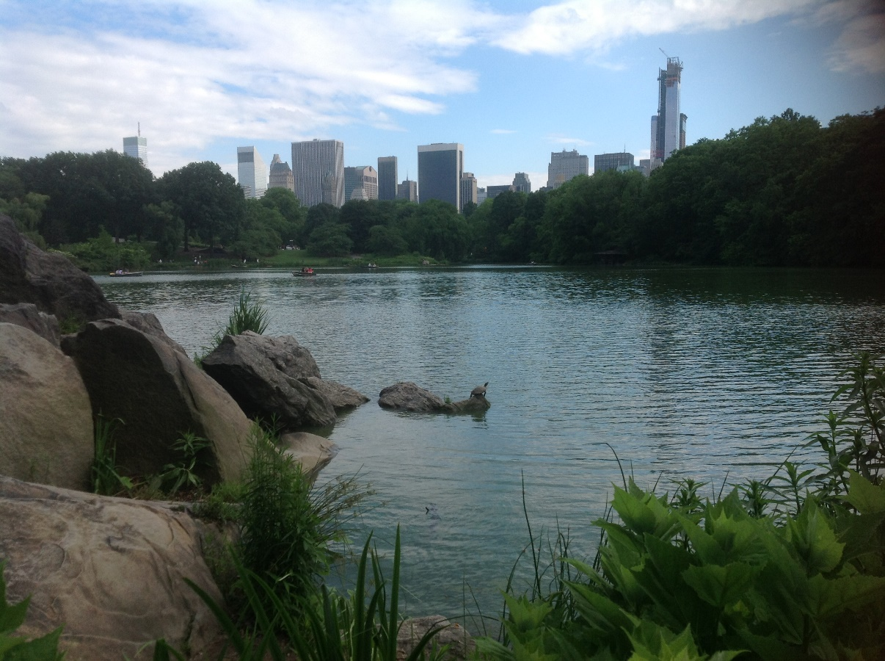
Objective
To identify the factors that characterize cities having activities of sustainable development in order to know what variables make cities more prepared to design and implement sustainable actions in a context of competitiveness in Mexico

Slide 5
1. Sustainable development and competitiveness
Globalization
Economic pressures
Social changes
Integrative vision
Economy
Environment
Government
Society

Slide 6
1. Sustainable development and competitiveness
Quality of life
Environment
Quality of services
Access to knowledge
Economy
Environment
Government
Society
Sustainable actions
Competitiveness

Slide 7
2. Factors influencing sustainability activities
Literature:
Political culture
Institutional
Intergovernmental
Economic
Proposal:
Socio-demographic
Institutional
Economic
Urban
Sustainable activities
City’s characteristics
Outcomes
Outcomes

Slide 8
3. Actions for sustainability in Mexican Cities
Municipalities in Mexico
Duties of municipalities
Intergovernmental relations
Council
Information available
Selection of cities
Variables:
Background of people
Commissions
Initiatives
Water treatment
Planted trees
Regulations

Slide 9
Characteristics of cities in the country
Background of people: 39% less than Bachelor´s degree; 40.4% Bachelor’s; 4% Master’s; 1.2% PhD.
Commissions: 4.6% about ecology and environment
Initiatives:2.3% on ecology and environment
Water treatment: 1470 sites in total; 596 in the cities studied
Program of water management: 28% have a program
Planted trees: 21 million in cities studied
Regulation: 90% of the cities studied

Slide 10
Cities with more sustainable activities
Activity | Cities
Commissions | Mexicali, Tijuana, Acapulco, Mexico City, Torreón
Initiatives | Mexico City, Zacatecas, Guadalajara, Toluca, Puebla
Water treatment | Mexico City, Colima, Aguascalientes, Acapulco, Guadalajara
Planted trees | Cuernavaca, Durango, Colima, Chetumal, Acapulco
Regulations | Chetumal, Cancún, Los Cabos, León, Nuevo Laredo
Cities having best background of people: Mexico City, Querétaro, Toluca, Monterrey, Acapulco, Guadalajara, Puebla, Nuevo Laredo, Zacatecas

Slide 11
Cities with sustainable activities vs level of competitiveness
City | Economic | Institutional | Socio-demographic | Urban | Index | Level
Mexico City | 25 | 42 | 22 | 1 | 1 | High
Aguascalientes | 9 | 11 | 15 | 25 | 8 | High
Guadalajara | 27 | 15 | 26 | 2 | 9 | High
Tijuana | 21 | 22 | 8 | 14 | 11 | High
Mexicali | 15 | 37 | 14 | 10 | 13 | High
Torreón | 10 | 25 | 25 | 34 | 14 | High
Durango | 34 | 2 | 20 | 35 | 15 | Medium
Cuernavaca | 24 | 20 | 29 | 7 | 16 | High
Nuevo Laredo | 29 | 8 | 24 | 39 | 18 | High
Puebla | 8 | 19 | 49 | 9 | 19 | Medium
Cancún | 48 | 6 | 3 | 28 | 20 | Medium
Los Cabos | 42 | 16 | 1 | 44 | 21 | High
León | 22 | 18 | 36 | 33 | 24 | Medium
Zacatecas | 56 | 30 | 6 | 13 | 30 | Medium
Toluca | 12 | 49 | 44 | 37 | 32 | Medium
Colima | 62 | 32 | 31 | 21 | 38 | Medium
Chetumal | 55 | 14 | 59 | 59 | 51 | Low
Acapulco | 68 | 26 | 57 | 63 | 58 | Low

Slide 12
Factors defining Mexican Cities in sustainability
Unemployment
Production
Salaries
Infraestructure
Public finance
Capacities of local government
High and medium levels of competitiveness
Institutional variables: profile of people, mechanisms and tools for better management
Low levels of competitiveness

Slide 13
Conclusions
The outcomes depend on the characteristics of cities
Level of competitiveness is related to sustainability
Government management, population dynamism, availability of infrastructure and facilities
Still more work to do
Need for more information

