Slide 1
Urban sustainability and competitiveness:
Factors defining Mexican cities
Isela Orihuela

Slide 2
Introduction
Relevance of the term
Same guidelines different outcomes
Situation in Mexican cities
Relationship with competitiveness

Slide 3
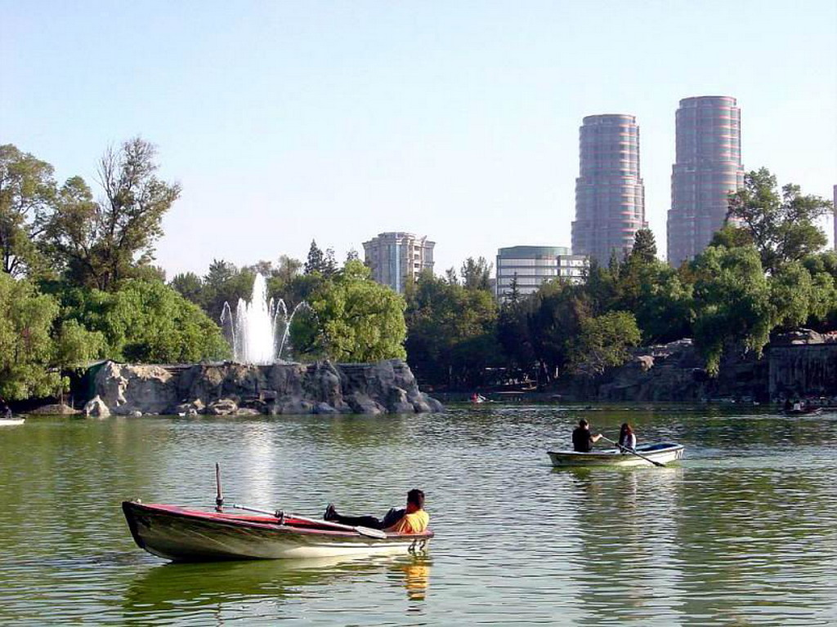
Objective
To identify the factors that characterize cities having activities of sustainable development in order to know what variables make cities more prepared to design and implement sustainable actions in a context of competitiveness in Mexico

Slide 4
Contents
Sustainable development and urban competitiveness
Factors influencing sustainability actions
Actions for sustainability in Mexican Cities
Factors defining Mexican Cities
Final comments

Slide 5
1. Sustainable development and competitiveness
Globalization
Economic pressures
Social changes
Integrative vision
Economy
Environment
Government
Society

Slide 6
1. Sustainable development and competitiveness
Quality of life
Environment
Quality of services
Access to knowledge
Economic
Urban
Institutional
Social
Different
Sustainable actions
Competitiveness

Slide 7
2. Factors influencing sustainability activities
Literature:
Political culture
Institutional
Intergovernmental
Economic
Proposal:
Socio-demographic
Institutional
Economic
Urban
Sustainable activities
City’s characteristics
Outcomes
Outcomes

Slide 8
3. Actions for sustainability in Mexican Cities
Municipalities in Mexico
Duties of municipalities
Intergovernmental relations
Council
Information available
Selection of cities
Variables:
Background of people
Commissions
Initiatives
Water treatment
Planted trees
Regulations

Slide 9
Background of people
People | No Bachelor’s | Bachelor’s | Master’s | PhD
President | 39% | 40% | 4% | 1%
Trustee | 49% | 35% | 3% | 0.5%
Councilmember | 58% | 29% | 2% | 0.3%

Slide 10
Commissions
30 Different topics
Most important: public works, government, finance
Environment and Ecology: 4.6%, 9th place
Related to main activities of municipal government
Importance of environmental affairs: use of the term, environmental problems
Cities: Mexico City, Toluca, Querétaro, Puebla, Guadalajara, Torreón, Monterrey

Slide 11
Initiatives
30 main topics
Most important: public works, finance, government
Environment and Ecology: 2.3%, 14th position
More commissions than initiatives
Mexico City has the largest number of all topic of initiatives
Most important: Mexico City, Zacatecas, Guadalajara, Toluca, Puebla

Slide 12
Water treatment
Total sites 1470, cities 596
Mexico City has the largest proportion
Most important cities: Mexico City, Colima, Aguascalientes, Acapulco, Guadalajara
Almost all cities have one
Only 10% do not have

Slide 13
Program for water management
28% have one program, 72% do not have a program
No information at city level
Program | Proportion of cities
New culture of water | 23%
Improving service provision | 4.9%
Strategic administration for water resources | 1%
Water quality | 8.3%
Service management | 5.4%
Flow recovery | 3%

Slide 14
Planted trees and regulation for environment
Planted trees:
  21 million in cities
  Most important cities: Cuernavaca, Durango, Colima, Chetumal, Acapulco
  60 % of cities have this activity; 40% do not have
Regulation for environment:
  90% have this regulation
  30% have regulation and it is updated
  17% have regulation not updated
  Most important cities: Chetumal, Cancún, Los Cabos, León, Nuevo Laredo

Slide 15
Cities with more sustainable activities
Activity | Cities
Commissions | Mexicali, Tijuana, Acapulco, Mexico City, Torreón
Initiatives | Mexico City, Zacatecas, Guadalajara, Toluca, Puebla
Water treatment | Mexico City, Colima, Aguascalientes, Acapulco, Guadalajara
Planted trees | Cuernavaca, Durango, Colima, Chetumal, Acapulco
Regulations | Chetumal, Cancún, Los Cabos, León, Nuevo Laredo
Cities having best background of people: Mexico City, Querétaro, Toluca, Monterrey, Acapulco, Guadalajara, Puebla, Nuevo Laredo, Zacatecas

Slide 16
Cities with sustainable activities vs level of competitiveness
City | Economic | Institutional | Socio-demographic | Urban | Index | Level
Mexico City | 25 | 42 | 22 | 1 | 1 | High
Aguascalientes | 9 | 11 | 15 | 25 | 8 | High
Guadalajara | 27 | 15 | 26 | 2 | 9 | High
Tijuana | 21 | 22 | 8 | 14 | 11 | High
Mexicali | 15 | 37 | 14 | 10 | 13 | High
Torreón | 10 | 25 | 25 | 34 | 14 | High
Durango | 34 | 2 | 20 | 35 | 15 | Medium
Cuernavaca | 24 | 20 | 29 | 7 | 16 | High
Nuevo Laredo | 29 | 8 | 24 | 39 | 18 | High
Puebla | 8 | 19 | 49 | 9 | 19 | Medium
Cancún | 48 | 6 | 3 | 28 | 20 | Medium
Los Cabos | 42 | 16 | 1 | 44 | 21 | High
León | 22 | 18 | 36 | 33 | 24 | Medium
Zacatecas | 56 | 30 | 6 | 13 | 30 | Medium
Toluca | 12 | 49 | 44 | 37 | 32 | Medium
Colima | 62 | 32 | 31 | 21 | 38 | Medium
Chetumal | 55 | 14 | 59 | 59 | 51 | Low
Acapulco | 68 | 26 | 57 | 63 | 58 | Low

Slide 17
Factors defining Mexican Cities in sustainability
Unemployment
Production
Salaries
Infraestructure
Public finance
Capacities of local government
High and medium levels of competitiveness
Institutional variables: profile of people, mechanisms and tools for better management
Low levels of competitiveness

Slide 18
Conclusions
The outcomes depend on the characteristics of cities
Level of competitiveness is related to sustainability
Government management, population dynamism, availability of infrastructure and facilities
Still more work to do
Need for more information

